Slide 1
Threading Part 4
CS221 – 4/27/09

Slide 2
The Final
Date: 5/7
Time: 6pm
Duration: 1hr 50mins
Location: EPS 103
Bring: 1 sheet of paper, filled both sides with typed and/or handwritten notes
Pick up: In the CS office starting 5/11

Slide 3
Test Review
Wednesday: Mindmap exercise
Friday: Review anything you need more time on. Answer questions.

Slide 4
Where We Left Off
Data integrity options:
Synchronized methods
Synchronized statements using locks
Atomic data access
Immutable objects
Order of operations options:
Guarded blocks
Locks

Slide 5
Liveness Problems
Can be broken into three categories:
Deadlock
Starvation
Livelock

Slide 6
Deadlock
Two or more threads are blocked on each other, waiting forever.

Slide 7
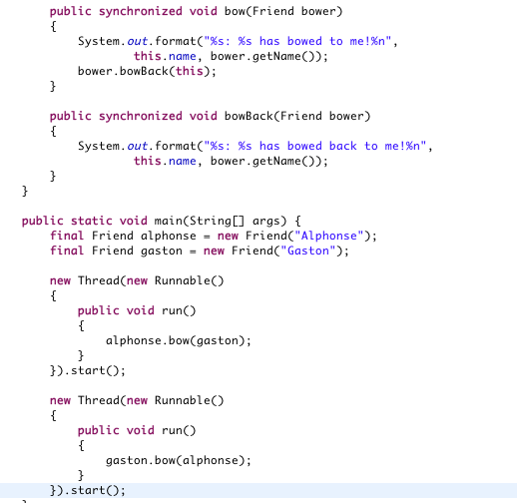
Example

Slide 8
Starvation
A thread needs access to a resource but cannot get it for long periods of time
Caused by a greedy thread which blocks other threads access to the resource
For instance
Imagine a synchronized method that is very slow to return
Thread 1 calls this method often
Thread 2, when calling the method, will often be blocked

Slide 9
Livelock
Thread 1 takes action in response to Thread 2
Thread 2 takes action in response to Thread 1
Threads aren’t blocked but they are in an endless loop of responses and won’t do other work.

Slide 10
Livelock Example
Alphonse moves to his left to let Gaston pass, while Gaston moves to his right to let Alphonse pass. Seeing that they are still blocking each other, Alphone moves to his right, while Gaston moves to his left. They're still blocking each other, so...

Slide 11
Guarded Blocks
In order to coordinate activity between two threads we can use Guarded Blocks
Wait() – puts a thread to sleep until it is notified
Notify() – wakes up one thread that is waiting on this object
NotifyAll() – wakes up all threads waiting on this object

Slide 12
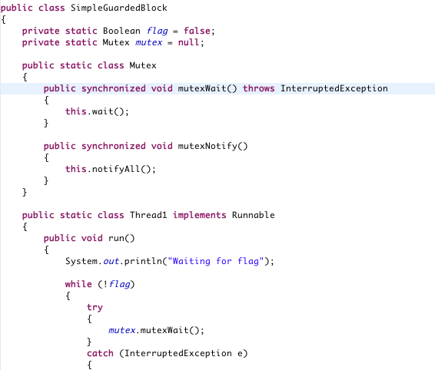
Guarded Blocks Example

Slide 13
Producer-Consumer Example
Remember the producer-consumer scenario?
Let’s look at a possible implementation
Recall, the previous pseudocode had a thread synchronization problem that could lead to deadlock.

Slide 14
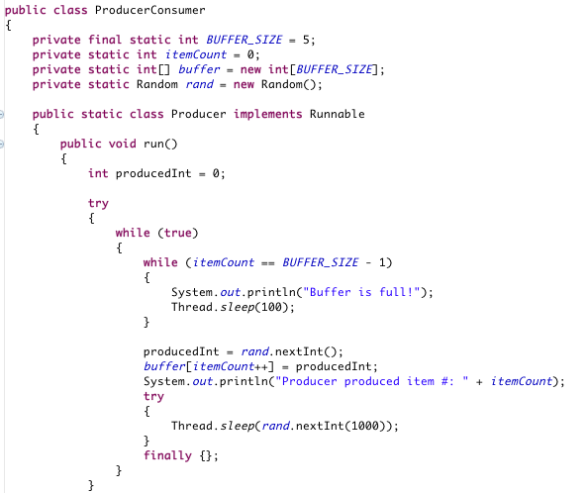
Producer-Consumer Example

Slide 15
Producer-Consumer Example
Our implementation is inefficient. Why?
How do we improve it?

Slide 16
Producer-Consumer Example
Things to Notice:
Sleep vs. Wait and Notify
Use of finally
Use of interrupt
What is the impact if we change the buffer size?
What is the impact if we modify the random timeouts?

Slide 17
Lock Objects
Recall that every object is associated with an intrinsic lock
In order for a thread to get exclusive access to an object, it must:
Acquire the lock before access
Release the lock when it is done

Slide 18
Lock Objects
Remember that synchronized methods and statements use locks implicitly:
Thread 1 acquires lock for the Counter object
Thread 1 calls increment method()
Thread 2 tries to acquire the lock
Thread 2 blocks
Thread 1 releases the lock
Thread 2 acquires lock for the Counter object
Thread 2 calls decrement() method

Slide 19
Lock Objects
Lock objects give you more sophisticated, explicit access to lock behavior
Java.util.concurrent.locks
http://java.sun.com/javase/6/docs/api/java/util/concurrent/locks/package-summary.html
“The framework permits much greater flexibility in the use of locks and conditions, at the expense of more awkward syntax.

Slide 20
Lock Objects
Like Intrinsic locks:
Only one thread can hold a lock object at a time
Lock objects support wait() and notify()
Lock objects add flexibility:
You can back out of an attempt to acquire a lock
Immediately
On a timeout
On an interrupt
There are a number of lock objects to choose from
Read/Write Lock – separate locks for read vs. write access
Condition – separate notification mechanisms

Slide 21
Example
Alphonse and Gaston are in a loop, continually bowing to each other
We want to acquire a lock for each friend before starting a bow
Let’s look at how lock objects can help

Slide 22
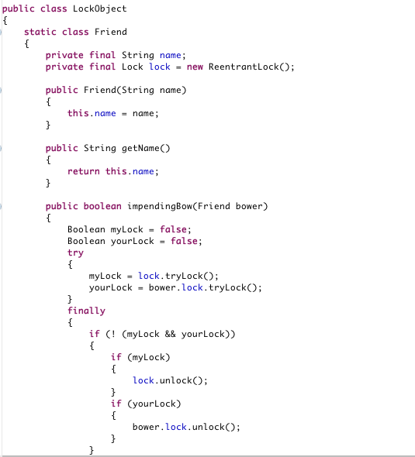
Example

Slide 23
Example
Things to Notice:
ReentrantLock Object: similar to an intrinsic lock
Use of tryLock()
Use of unlock()
The conditions under which both locks cannot be acquired

Slide 24
Concurrent Collections
Java supplies a set of concurrent collections you can use manage sets of data in a multi-threaded program
Examples
ArrayBlockingQueue
ConcurrentHashMap
ConcurrentNavigableMap

Slide 25
ArrayBlockingQueue
Queue data structure with some added benefits
Blocks when you attempt to add to a full queue
Blocks when you attempt to remove from an empty queue
Wakes up the blocked thread when the queue is ready once more
Safe to use with as many threads as you wish

Slide 26
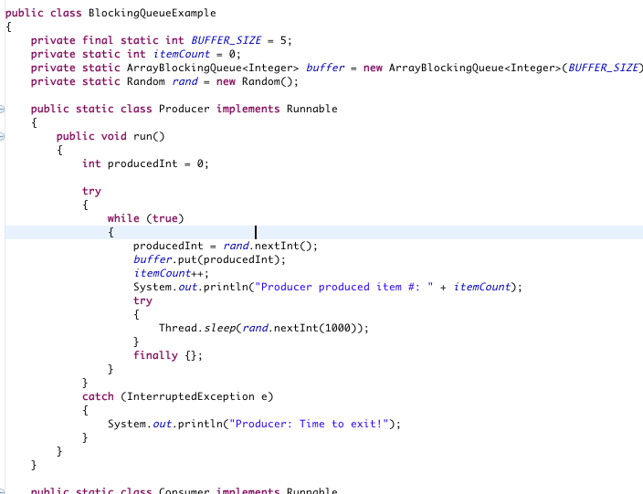
Example
Let’s convert producer-consumer to use this datastructure!

Slide 27
ConcurrentHashMap
Provides all the functionality of a hash table, plus it is thread-safe.
Allows you to add items to the data structure based on a key
Supports fast retrieval of the items based on the same key
Hashing is much faster than a search, but takes up more space

Slide 28
MultiThreaded Dots
Let’s convert our dot moving program to use multiple threads.
Steps
Decide what should be in each thread
Move MouseMotionListener to new thread
Move mouse event handlers to the new thread
Start the new thread from MoveComponent constructor

Slide 29
MultiThreaded Dots
To be safe: Convert Dots class to use Vector instead of ArrayList
Tip: Vector is thread-safe and ArrayList is not
Note: If we’d designed Dots class better we could have replaced ArrayList with Vector without having to modify the calling code.
What would have been a better way to design this class?

Slide 30
Semaphore
Semaphore is a generalized version of a mutex.
A mutex is mutually exclusive, only one thread can access at a time.
A semaphore can allow 1..n threads access at a time.
If you reduce semaphore to 1 thread, it is a mutex.
http://java.sun.com/javase/6/docs/api/java/util/concurrent/Semaphore.html

Slide 31
Thread Priorities
You can use thread priority to give some of your threads higher priority than others.
Higher priority threads will get more CPU cycles than lower priority threads

Slide 32
Example
Create an applet with two counting threads
See how the thread priority changes counting speed

Slide 33
